Slide 1



Infrastructure as Code

Slide 2


Joeri Maes
Tom Vandewinckele
Azure Data Architect
Solution Responsible

Slide 3
Let’s get to know all of you!

Slide 4
Agenda
What is IaC?
Why would you use IaC
Azure ARM
Azure Bicep
Terraform
Demo
Questions?

Slide 5
What is Infrastructure as Code
Traditional deployment
Virtualization and public cloud
Define infrastructure components in version-controlled code
Declarative
Imperative

Slide 6
Why?
Configuration drift vs environment consistency
Technical debt
Fear of change vs frequent deployments
Improvement at the bottleneck

Slide 7
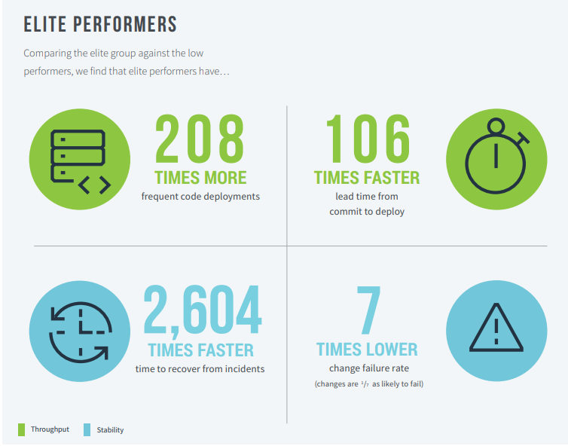
Why?
Notes:
Manual configuration
Configuration drift
Fear of change
Repetetive tasks
Technical debt
IaC
Environment consistency
Cycle time
Modularisation and code reuse
Improvement of the bottleneck

Slide 8
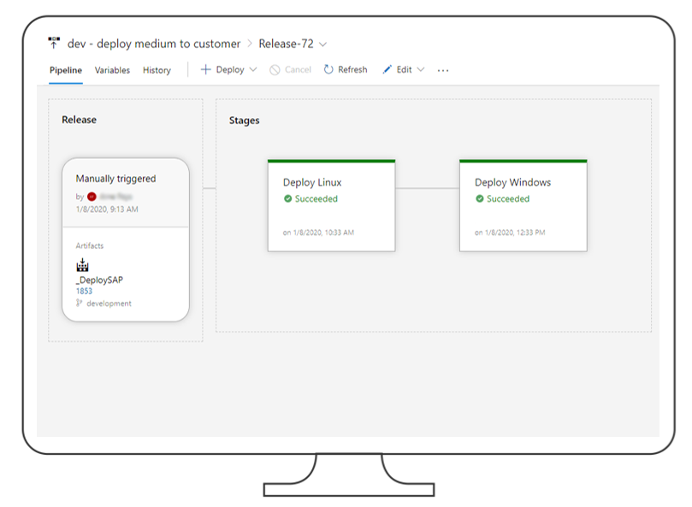

Concrete delaware example
SAP S/4HANA on Azure
2h vs 3 days Deployment Time
Notes:
Manual configuration
Configuration drift
Fear of change
Repetetive tasks
Technical debt
IaC
Environment consistency
Cycle time
Modularisation and code reuse
Improvement of the bottleneck

Slide 9


Bicep / ARM
vs
Terraform

Slide 10

Azure Resource Manager Templates (ARM)
Management layer for the Azure control plane
Template & parameter files
JSON syntax
Built-in functions (loops, string operations, etc.)

Slide 11
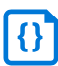
Azure Resource Manager Templates (ARM)
Parameters TST
MyApp
Web App
Referenced by
Template
Parameters QAS
SQL DB
Parameters PRD

Slide 12
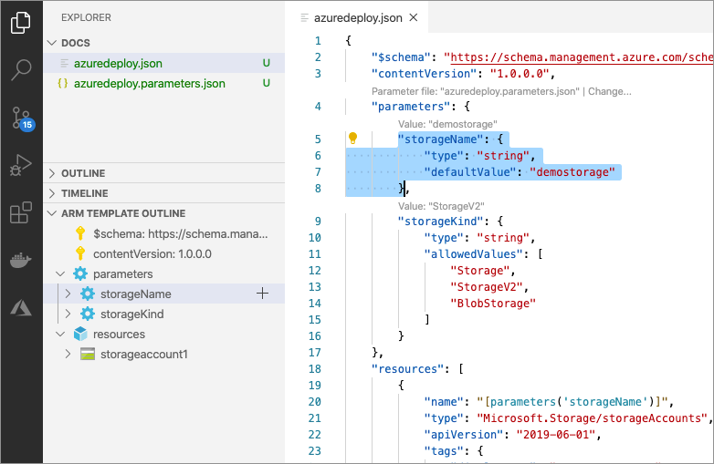
Tooling: ARM Tools extension for VS Code
Helps to create templates:
language support
resource snippets
resource auto-completion
Validation:
Schema validation
Missing or wrong parameters

Slide 13
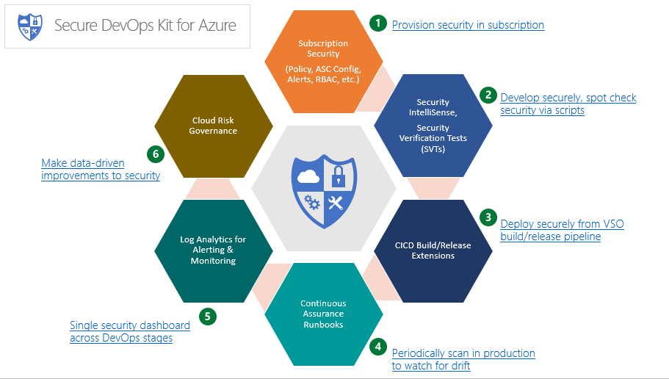
Tooling: AzSDK

Slide 14
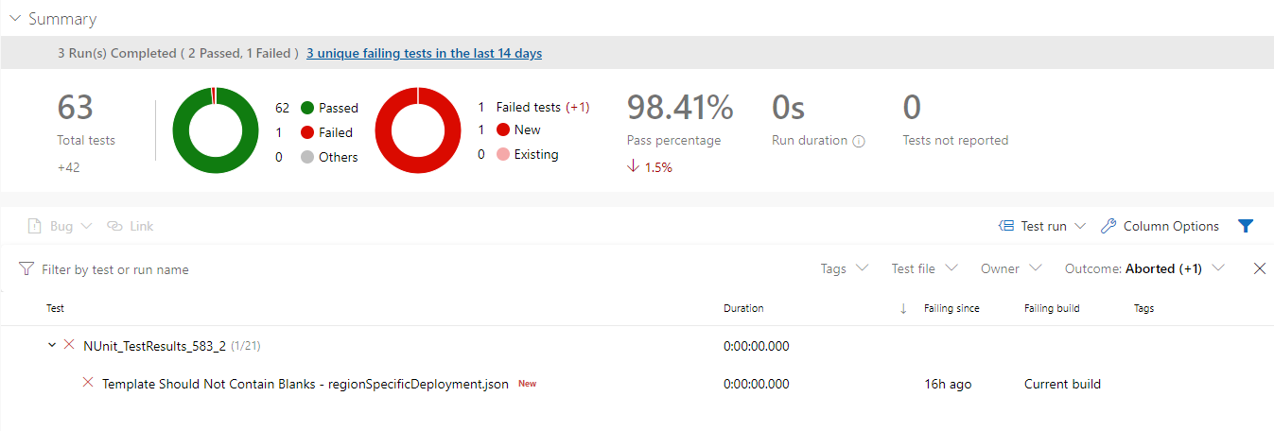
Tooling: ARM TTK
Static Code Analysis for ARM templates
Additional value on top of the /validate API
Example Tests:
Templates are using a valid schema
Locations are not hardcoded
Outputs don't contain secrets
ID's are derived from resource ID's
Templates do not contain blanks

Slide 15


Bicep
Transparent abstraction over ARM (full compatibility aimed for)
To drastically simplify the authoring experience
Microsoft Azure only
Compiles down to ARM
Bicep
bicep build
ARM Templates
az deployment create

Slide 16

Bicep: what’s improved vs ARM? (v0.2)
Simpler syntax (no more [ ], no more concats,…)
More modular structure <> linked templates
Automatic dependency management
Richer validation & intellissense
Flexible declaration of types

Slide 17

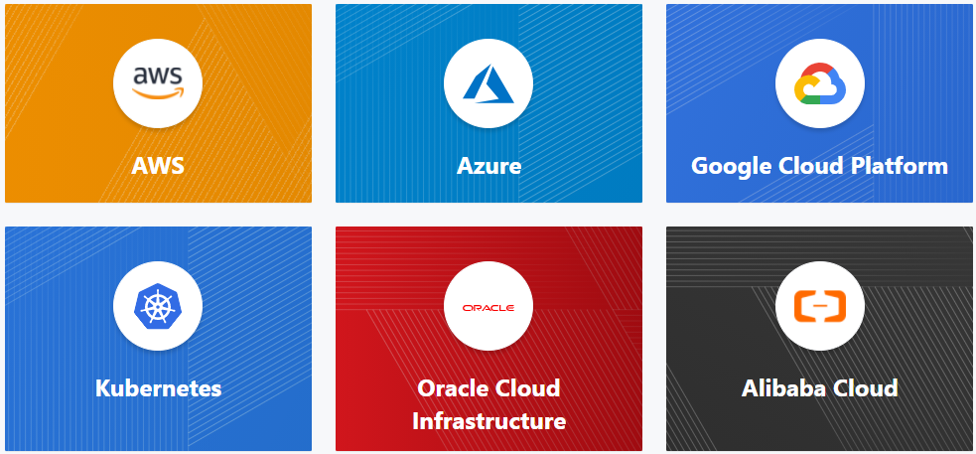
Terraform
Generic CCA tool using APIs
Azure RM provider
Azure Devops provider
Azure AD provider
State file
Notes:
Syntactically similar to bicep
API usage
Azure REST API
Azure DevOps REST API
Azure AD REST API
Create your own provider
HCL
State file
Modulaor

Slide 18

DEMO TIME

Slide 19
Terraform
Notes:
Logging
Back-up
Azure Defender
Service/private endpoints
Service principals
Managed identities

Slide 20
Bicep / ARM vs Terraform
 | ARM | Bicep | Terraform
Cross Platform | Azure only. | Azure only. AAD in the long-term planning. | Generic Rest API
Azure Portal Support | Azure Blueprints, Azure Managed Apps & Service Catalog Azure Template Specs |  | Non existing
Easy of use | Complexity rises quickly | Pleasant experience | Pleasant experience
Modularity | Hard, via linked templates | Built-in | Built-in
Testability | Some, but not optimal Quite some 3rd party tooling ARM-TTK / AzSDK | Good | Good
Error Descriptiveness | Clear error but difficult to find |  | Clear errors Debugging requires practice
State Management | MS Azure is your state machine; worry free |  | Your responsibility

Slide 21
Reference docs
Slides: https://github.com/delawarePro/techorama-iac
Azure Resource Manager
Docs: https://docs.microsoft.com/en-us/azure/azure-resource-manager/templates/overview
Quickstart: https://github.com/Azure/azure-quickstart-templates
Bicep: https://github.com/Azure/bicep
Terraform: Introduction - Terraform by HashiCorp

Slide 22

Don’t hesitate to reach out
Joeri Maes
Tom Vandewinckele
Azure Data Architect
joeri.maes@delaware.pro
Solution Responsible
tom.vandewinckele@delaware.pro

Slide 23

THANK YOU

